Slide 1
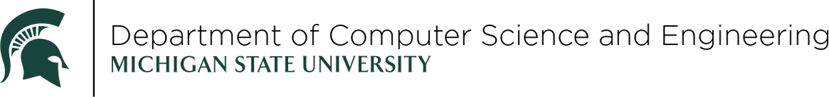
MOAZ: A Multi-Objective AutoML-Zero Framework
GECCO 2023 Presentation
Ritam Guha, Wei Ao, Stephen Kelly, Vishnu Boddeti, Erik Goodman, Wolfgang Banzhaf and Kalyanmoy Deb
07/18/2023

Slide 2

Overview
Background [4 mins]
AutoML
AutoML-Zero framework (by Real et. al. (2020))
Introduction
Structure
Issues
MOAZ [5 mins]
Introduction
Structure
Results and Discussions [5 mins]
Linear Regression
Non-Linear Regression
Conclusions [1 min]

Slide 3


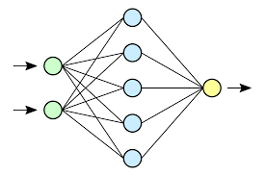
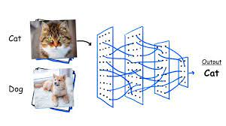
AutoML: Automated Machine Learning
Bottleneck in Traditional Machine Learning (ML)
Developing ML algorithms for a field requires significant human intervention, design expertise and resources.
Algorithms require separate operators tuned for different types of problems/data.
AutoML – A way of removing the bottleneck
AutoML is a systematic way to automatically find a working ML algorithm for a problem class.
It is an upper-level automation over traditional ML.
The field is still not perfect for high scale ML, but it has seen tremendous progress over recent years.
Human Designer
Traditional Way
Algo Designer
AutoML Way

Slide 4
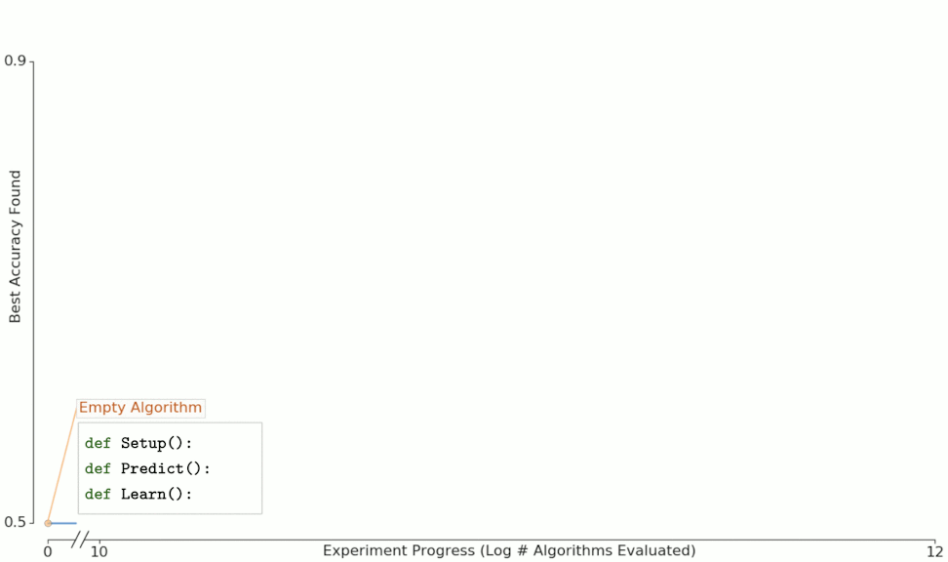
AutoML-Zero: Introduction
Problems in AutoML:
AutoML searches for good solutions out of billions of possibilities, which is not trivial.
Usually, a smaller search space with reasonable operators is designed for particular problem classes. They are not usually generic.
AutoML-Zero: Evolving Machine Learning Algorithms from Scratch
Real et al.’s AZ was the first framework that used 65 high-school level operators in the search space and was able to provide solutions to regression and binary image classification.

Slide 5
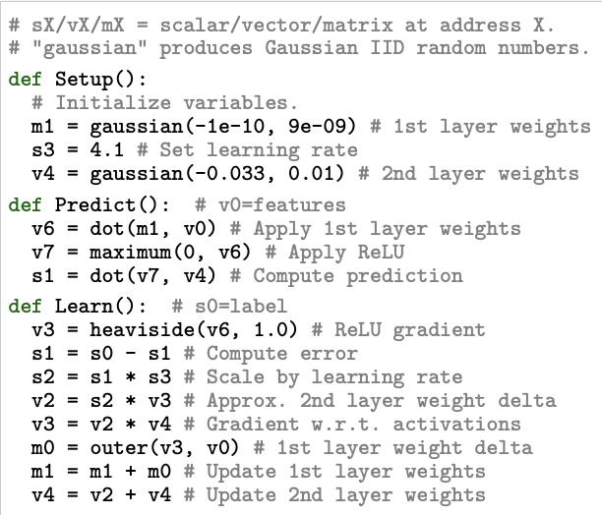
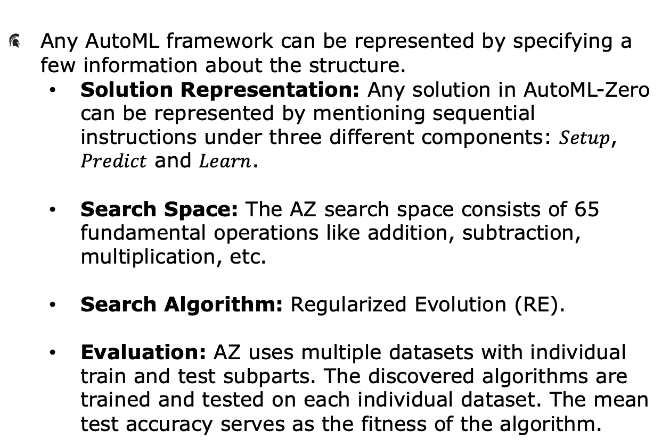
AutoML-Zero: Structure
Any AutoML framework can be represented by specifying a few information about the structure.
Solution Representation: Any solution in AutoML-Zero can be represented by mentioning sequential instructions under three different components: $Setup$, $Predict$ and $Learn$.
Search Space: The AZ search space consists of 65 fundamental operations like addition, subtraction, multiplication, etc.
Search Algorithm: Regularized Evolution (RE).
Evaluation: AZ uses multiple datasets with individual train and test subparts. The discovered algorithms are trained and tested on each individual dataset. The mean test accuracy serves as the fitness of the algorithm.

Slide 6
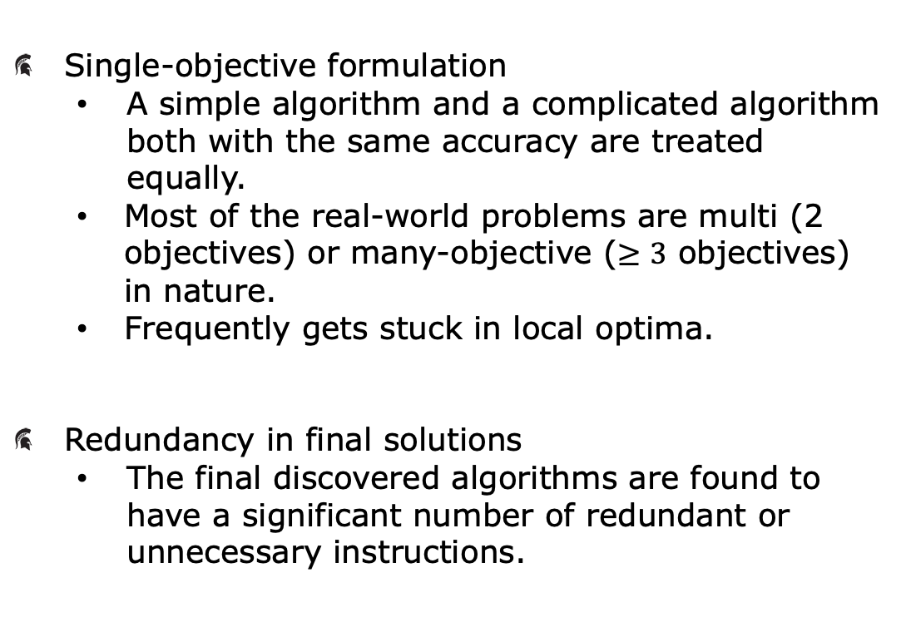
AutoML-Zero: Issues
Single-objective formulation
A simple algorithm and a complicated algorithm both with the same accuracy are treated equally.
Most of the real-world problems are multi (2 objectives) or many-objective ($≥3$ objectives) in nature.
Frequently gets stuck in local optima.
Redundancy in final solutions
The final discovered algorithms are found to have a significant number of redundant or unnecessary instructions.
AZ
Multi-objectivization
+
MOAZ

Slide 7
Multi-objective AutoML-Zero (MOAZ): Introduction
AZ Framework
MOAZ Framework
There are two things which are different in MOAZ:
Evaluation: MOAZ deals with two contradicting objectives – Accuracy and Complexity, while AZ had only one objective i.e., Accuracy.
Search Algorithm: NSGA-II, one of the most popular multi-objective optimization algorithms in the literature.
Solution Representation
Solution Representation
Search Space
Search Space
Search Algorithm
Search Algorithm
Customized
NSGA2
RE
Evaluation
Evaluation
Accuracy &
Complexity
Accuracy

Slide 8
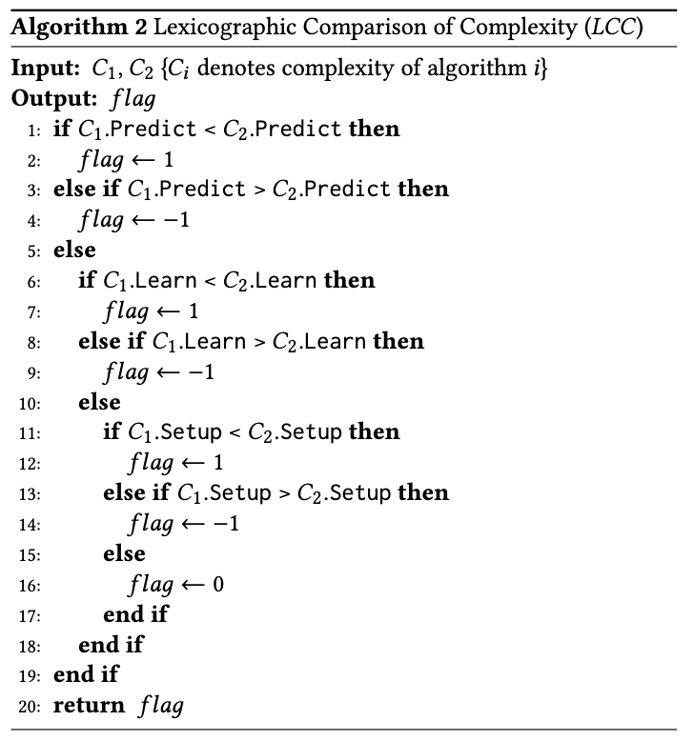
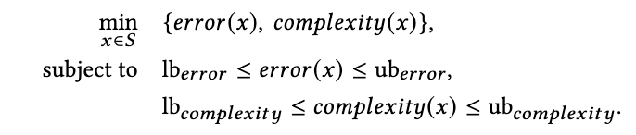
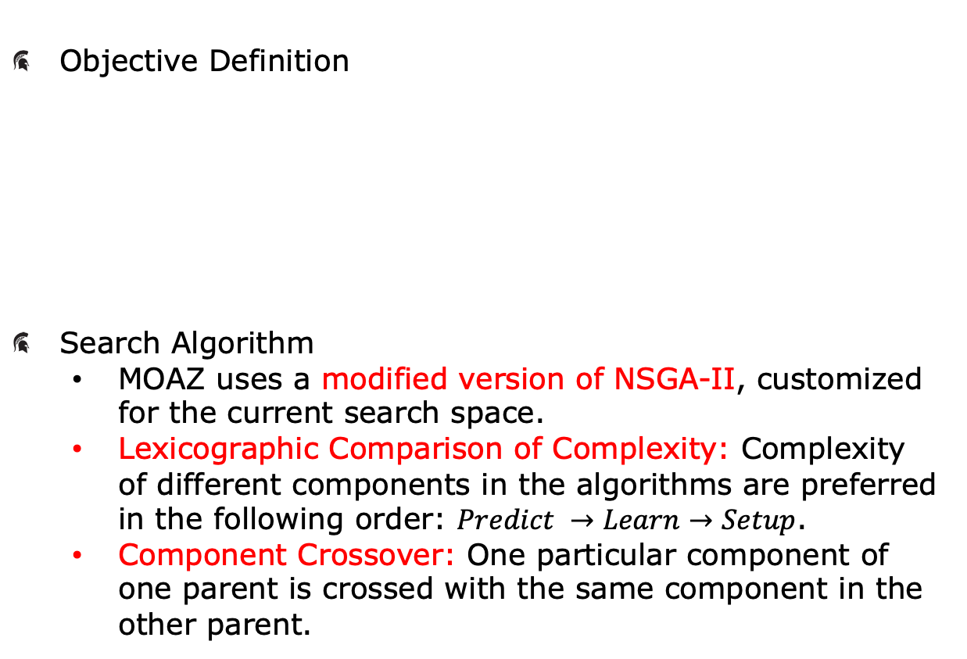
MOAZ: Structure
Objective Definition
Search Algorithm
MOAZ uses a modified version of NSGA-II, customized for the current search space.
Lexicographic Comparison of Complexity: Complexity of different components in the algorithms are preferred in the following order: $Predict →Learn→Setup$.
Component Crossover: One particular component of one parent is crossed with the same component in the other parent.
Average error on
the test datasets
FLOPs of the
algorithms

Slide 9
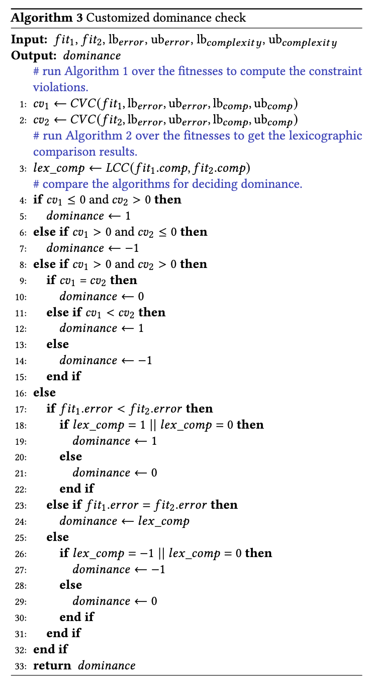




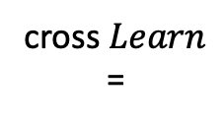









NSGA-II Modifications
Customized Domination Check
Component Crossover
Parent 1
Parent 2
$$Setup_{1}$$
$$Setup_{2}$$
$$Predict_{1}$$
$$Predict_{2}$$
$$Learn_{1}$$
$$×$$
$$Learn_{2}$$
cross $Learn$
=
Child 1
Child 2
$$Setup_{1}$$
$$Setup_{2}$$
$$Predict_{1}$$
$$Predict_{2}$$
$$Learn_{2}$$
$$Learn_{1}$$

Slide 10


Slide 11
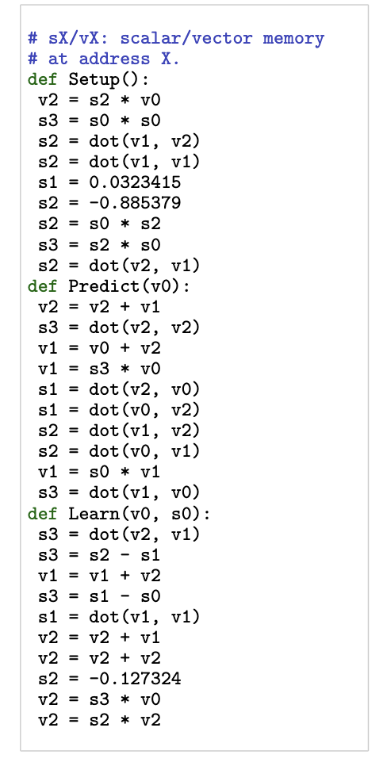
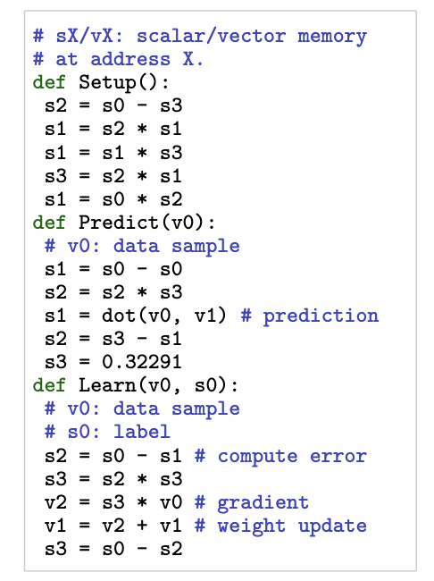

Results: Linear Regression
The linear regression problem for $d$-dimensions is created by sampling some random $d$-dimension weight vectors from standard Gaussian distribution. The weights are then multiplied by data points to create the corresponding labels.
Initial experiments are done with $d = 4$ and a target error ($e_{T}$) of 0.1.
AZ solution
for a single run:
MOAZ solution
for a single run:
Complexity: 136
Error: 0
Complexity: 28
Error: 0

Slide 12
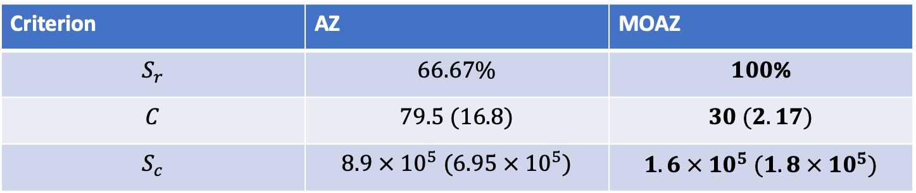
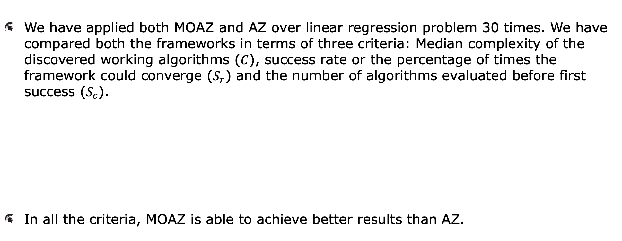
Results: Linear Regression (Multiple Runs)
We have applied both MOAZ and AZ over linear regression problem 30 times. We have compared both the frameworks in terms of three criteria: Median complexity of the discovered working algorithms ($C$), success rate or the percentage of times the framework could converge ($S_{r}$) and the number of algorithms evaluated before first success ($S_{c}$).
In all the criteria, MOAZ is able to achieve better results than AZ.
Criterion | AZ | MOAZ
$$S_{r}$$ | $$66.67\%$$ | $$100\text{\%}$$
$$C$$ | $$79.5 (16.8)$$ | $$30 (2.17)$$
$$S_{c}$$ | $$8.9 × {10}^{5} (6.95 × {10}^{5})$$ | $$1.6 × {10}^{5} (1.8 × {10}^{5})$$

Slide 13
Results: Linear Regression (Multiple Runs)
Swarm plots of MOAZ and AZ solutions reveal the distribution of the solutions in terms of error, complexity and convergence speed.
For MOAZ, error has a nice distribution between 0 and 0.6, complexity is always lower as compared to AZ and convergence speed is also mostly superior.

Slide 14
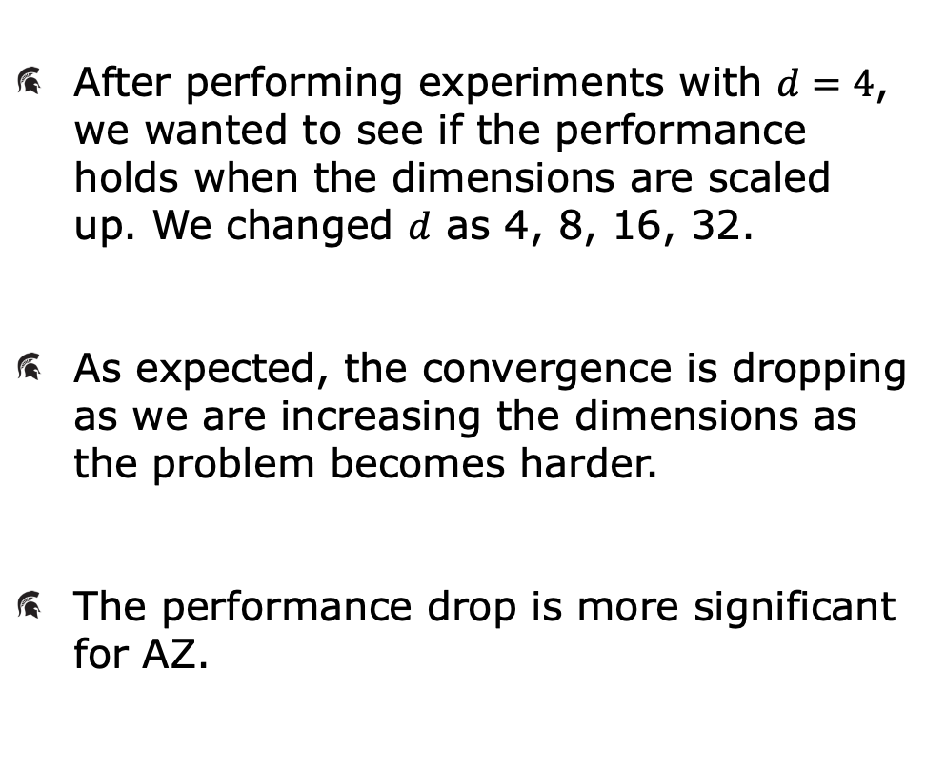
Results: Linear Regression (Scaling Up)
After performing experiments with $d=4$, we wanted to see if the performance holds when the dimensions are scaled up. We changed $d$ as 4, 8, 16, 32.
As expected, the convergence is dropping as we are increasing the dimensions as the problem becomes harder.
The performance drop is more significant for AZ.

Slide 15
Results: Non-Linear Regression
The non-linear regression problem dataset is created using a teacher neural network. The dataset is generated by the outputs of the neural network for different inputs. The frameworks need to find the code for this teacher neural network.
The best solution found by AZ has a complexity of 107, while MOAZ has found a solution of complexity 95. But the original complexity of the teacher neural network is 75.
MOAZ gets multiple approximations of the teacher neural networks where some of the approximations even have lesser complexity than the original network which might have a lot of applications.

Slide 16


Slide 17
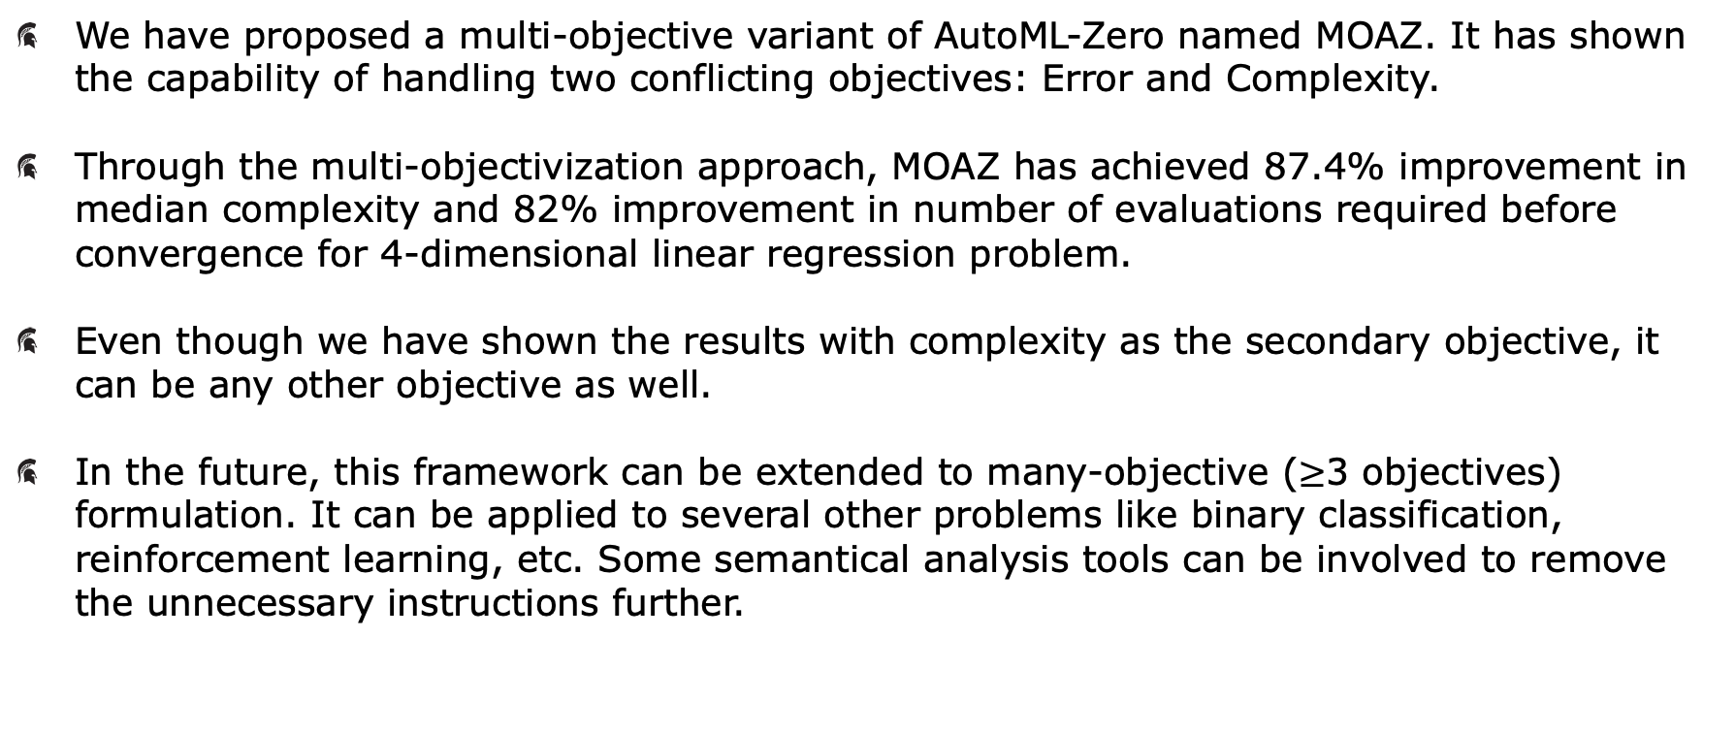
Conclusions and Future Work
We have proposed a multi-objective variant of AutoML-Zero named MOAZ. It has shown the capability of handling two conflicting objectives: Error and Complexity.
Through the multi-objectivization approach, MOAZ has achieved 87.4% improvement in median complexity and 82% improvement in number of evaluations required before convergence for 4-dimensional linear regression problem.
Even though we have shown the results with complexity as the secondary objective, it can be any other objective as well.
In the future, this framework can be extended to many-objective ($≥$3 objectives) formulation. It can be applied to several other problems like binary classification, reinforcement learning, etc. Some semantical analysis tools can be involved to remove the unnecessary instructions further.
For further information, visit https://www.coin-lab.org

Slide 18
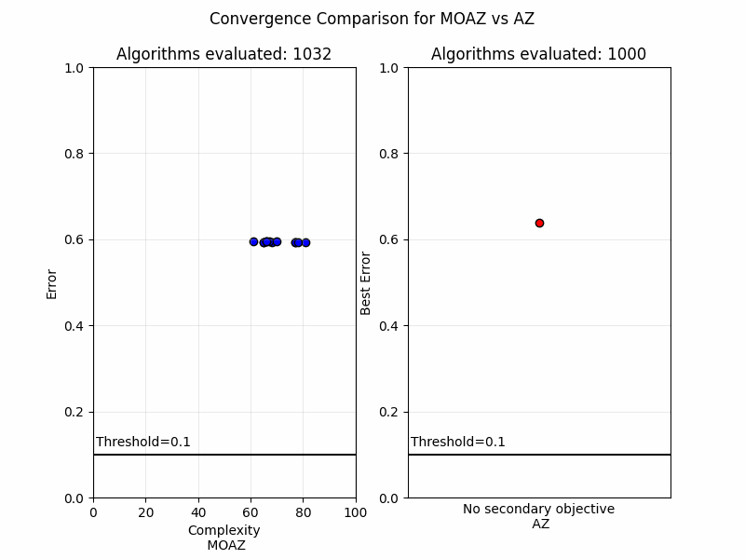
Thank You !!

