Slide 1
Neural Architecture Transfer
Zhichao Lu, Gautam Sreekumar, Erik Goodman, Wolfgang Banzhaf,
Kalyanmoy Deb, and Vishnu Naresh Boddeti
Michigan State University
NAT, CVPRW’20

Slide 2
Challenge: Efficient Search on Diverse Deployment Scenarios
Data
Hardware
Requirement
Multi-class / Fine-grained Large-scale / Few examples
Professional GPU / Mobile / IoT, …
Latency, Power consumption, Memory, …
Deployment scenarios comprise of different types of data, and possibly many objectives that need to be simultaneously improved on single or multiple hardware platforms.
We need a neural architecture search (NAS) method that is efficient and scalable in finding the best set of trade-off models for diverse deployment scenarios.
NAT, CVPRW’20

Slide 3
Challenge: Efficient Search on Diverse Deployment Scenarios
Previous works
This work (NAT)
Dataset Searched (# Papers)*
Objective Searched (# Papers)*
11
12
CIFAR-10
Acc only
ImageNet
Bi-objectives
Others
< 5%
3+ objectives
~ 2%
Dataset
Searched
Objective
Searched
Existing NAS methods evaluate on few datasets (CIFAR-10 and ImageNet), and objectives (< 3).
We demonstrate the practical utility of NAT on 11 datasets and 12 objectives.

Slide 4



Current Approach
Architecture
Weights
C-10 / ImageNet
$NAS$
Standard
Datasets
$$\&$$
Transfer
(and keep fixed)
Fine-tune
Flowers / Food / Cars / …
Fixed architecture regardless of task difficulty
Other
Datasets
Inefficient (over parameterized)
Deficient (under parameterized)
$$+$$
NAT, CVPRW’20

Slide 5


Our Approach: NAT
SuperNet
Architecture
Inherit
Weights
$NAT$
Standard
Datasets
$$\&$$
Transfer + fine-tune
$NAT$
Other
Datasets
$$\&$$
Task-specific architectures
<-- better accuracy-efficiency trade-off

Slide 6
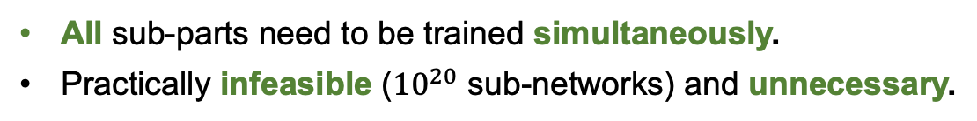
NAT: Many-Obj EA + SuperNet + …
Existing Approach*
(Decoupled from Search)
Train the full model
Randomly select sub-networks
Fine-tune sub-networks
Architecture search
All sub-parts need to be trained simultaneously.
Practically infeasible (${10}^{20}$ sub-networks) and unnecessary.
Our Approach
(Guided by Search)
Output
Train the full model
Many-objective evolutionary search
Promising sub-networks
Fine-tune sub-networks
Fine-tune only sub-networks that will eventually lie on Pareto front.
Practically trackable and efficient.

Slide 7
NAT: Many-Obj EA + SuperNet + Transfer Learning + …
Initialize weights from SuperNet trained on ImageNet
On specific dataset
Train the full model
Many-objective evolutionary search
Promising sub-networks
Fine-tune sub-networks
Train one SuperNet for each dataset from-scratch is computationally intensive.
Leverage existing SuperNet and transfer to dataset-specific SuperNet.
Transfer learning from ImageNet improves both efficiency and accuracy*.

Slide 8

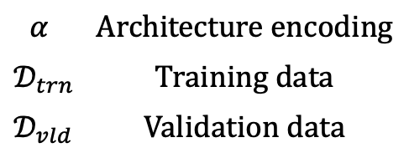




NAT: Many-Obj EA + SuperNet + Transfer Learning + Acc Predictor
Transfer Learning
Train the full SuperNet
Accuracy Predictor
Many-objective evolutionary search
Promising sub-networks
Fine-tune sub-networks
$$\text{Computational} \text{cost}$$
 | $$\text{Hours}$$
 | $$\text{Mins}$$
 | $$\text{Secs}$$
$$α$$ | $$A\text{rchitecture} \text{encoding}$$
$$𝒟_{trn}$$ | $$\text{Training} \text{data}$$
$$𝒟_{vld}$$ | $$\text{Validation} \text{data}$$

Slide 9





NAT: Performance of Accuracy Predictor
random subsets of features
Mean and standard deviation across 11 datasets
$$α$$
$${\text{RBF}}_{1}$$
$${\text{RBF}}_{2}$$
$${\text{RBF}}_{k}$$
Ensemble
$$⋯$$
Our accuracy predictor is an ensemble of 500 RBF models, where each RBF is constructed from a random subset of features.
RBF ensemble consistently outperforms other standalone predictor models, especially with limited # of training samples.
NAT, CVPRW’20

Slide 10
NAT: Performance on ImageNet
Mobile setting (< 600M Multi-Adds)
higher the better
lower the better
NAT under bi-objective: ($↑$ max) top-1 accuracy and ($↓$ min) multi-adds
New state-of-the-art 80.5% ImageNet top-1 accuracy under mobile setting (0.5% improvement from OFA net*).

Slide 11



NAT: Scalability to Datasets
Comparison with EfficientNet
4$×$ more efficient
3$×$ more efficient
9$×$ more efficient
Oxford Flowers
#Class = 102
Train size = 20 images/class
Oxford-IIIT Pets
#Class = 37
Train size = 100 images/class
FGVC Aircraft
#Class = 100
Train size = 66 images/class
NAT is consistently more efficient (3x – 9x) than EfficientNet across various datasets without loss of accuracy.
NAT, CVPRW’20

Slide 12
NAT: Scalability to Datasets
Comparison with Other Models*
NAT use an order of magnitude less #multi-adds to achieve similar accuracy than existing models across a diverse set of datasets.
* We restrict the search to be < 1 Day on an 8 2080Ti GPU server

Slide 13
NAT: Scalability to Datasets
Visualization of NAT architectures
ImageNet
Stanford Cars
Food-101
Pareto-optimal architectures obtained by NAT under bi-objective: ($↑$ max) top-1 accuracy and ($↓$ min) multi-adds
Different datasets requires different architectures to optimally trade-off accuracy-efficiency.
Existing approaches that transfer architectures learned on ImageNet are sub-optimal.
NAT finds more efficient models with similar accuracy by searching directly on the dataset.
NAT, CVPRW’20

Slide 14
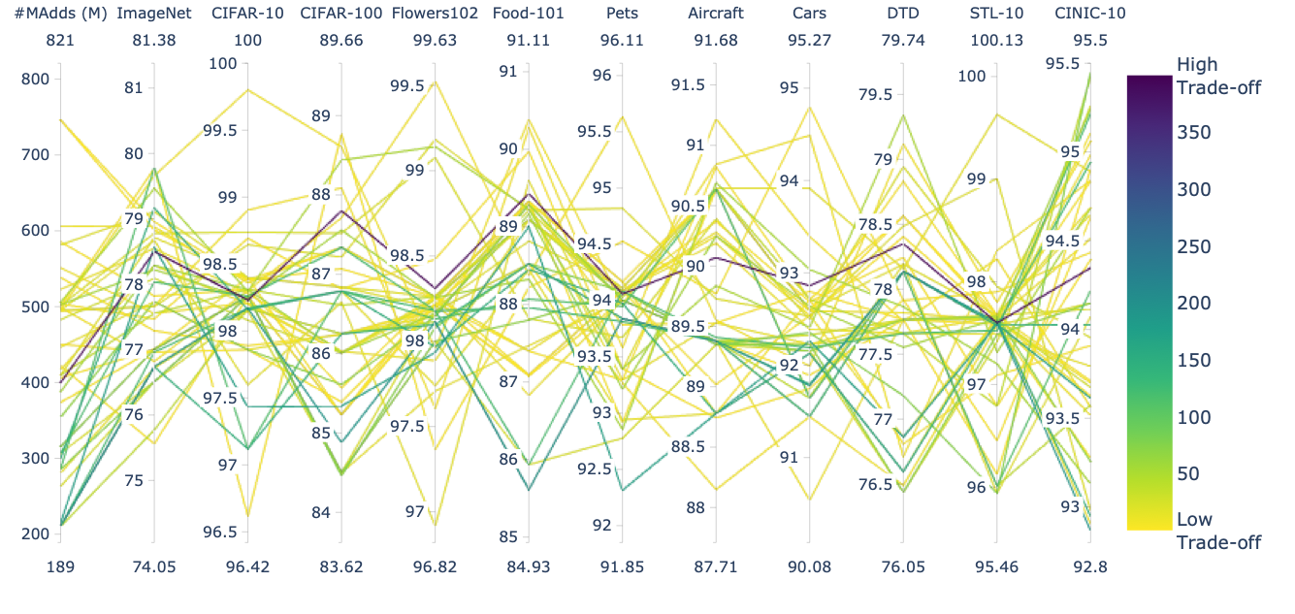
NAT: Scalability to Numbers of Objectives
NAT under 12-objective: ($↑$ max) top-1 accuracy on 11 datasets and ($↓$ min) multi-adds
NAT can handle many objectives and empirically show trade-offs exist among these 11 datasets.
NAT finds one common architecture that outperforms existing models on all 11 datasets with similar MAdds.
NAT, CVPRW’20

Slide 15
Summary
We introduce Neural Architecture Transfer for Efficient Search on Diverse Deployment Scenarios.
NAT is an integration of many-objective EA, SuperNet, transfer learning and accuracy predictor.
NAT surpasses existing approaches under various scenarios:
  Achieves a new state-of-the-art 80.5% ImageNet Top-1 accuracy under mobile setting.
  Outperforms EfficientNet and many other models by a large margin on a diverse set of datasets and objectives.
Released pre-trained NAT models on all 11 datasets @ https://github.com/human-analysis/neural-architecture-transfer
Transfer Learning
Train the full SuperNet
Accuracy Predictor
Many-objective evolutionary search
Promising sub-networks
Fine-tune sub-networks
NAT, CVPRW’20

