Slide 1

NSGA-Net: Neural Architecture Search using Multi-Objective Genetic Algorithm
Investigators:
Zhichao Lu, Ian Whalen, Vishnu Boddeti, Yashesh Dhebar, Kalyanmoy Deb, Erik Goodman, Wolfgang Banzhaf
Department of Electrical and
Computer Engineering
BEACON Center for Study of
Evolution in Action
Michigan State University
East Lansing, Michigan 48824
{luzhicha, whalenia, vishnu, dhebarya, kdeb, goodman, banzhafw}@msu.edu

Slide 2
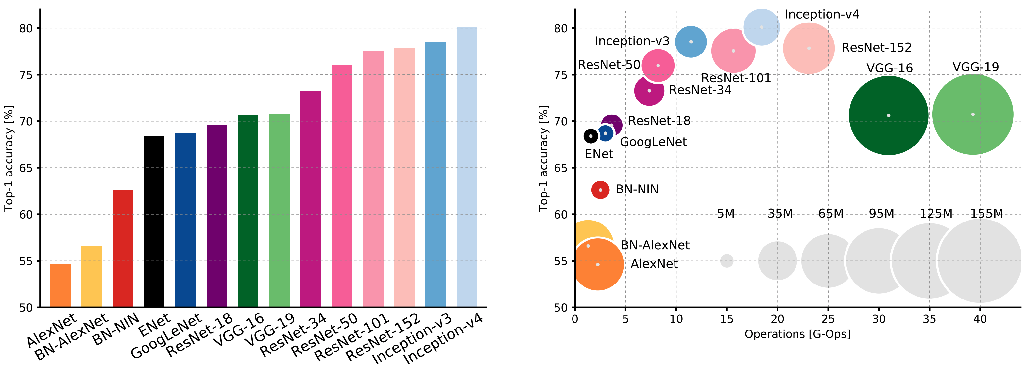
Importance of architecture for Vision
DNN has been overwhelmingly successful in various vision tasks.
One of key driving forces is the development in architectures.
Can we learn (or search) good architectures automatically?
25%+ more accurate
30M less Params
Canziani et al., 2017, arxiv.org/abs/1605.07678
Notes:
Design

Slide 3
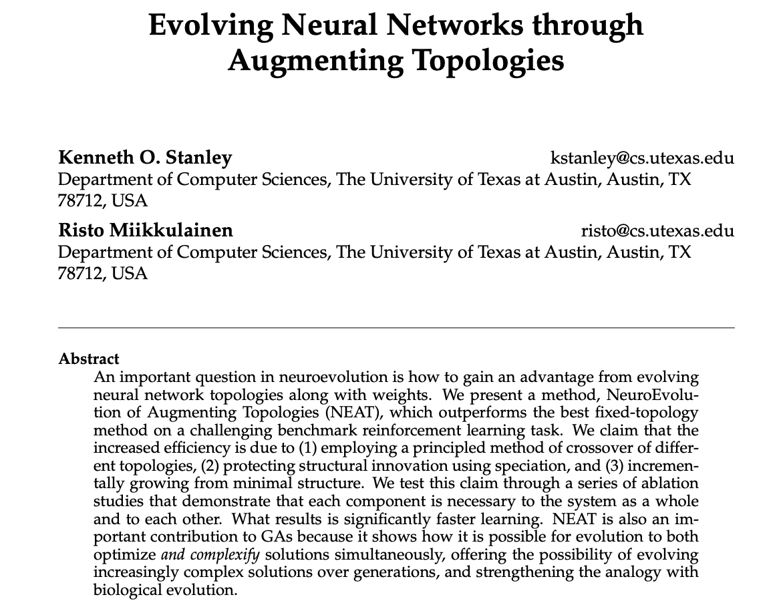
Background: Neural Architecture Search
Automate the process of designing neural network architectures.
Notes:
Design

Slide 4
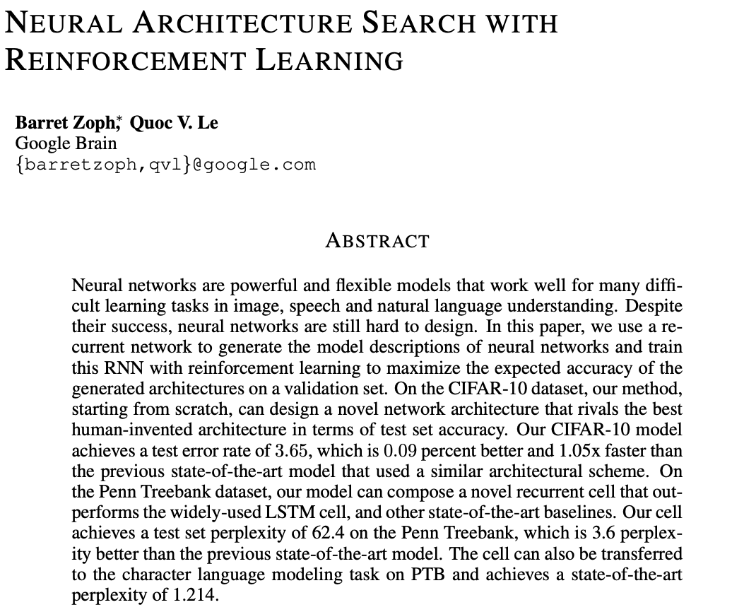
Background: Neural Architecture Search
Automate the process of designing neural network architectures.
Notes:
Design

Slide 5
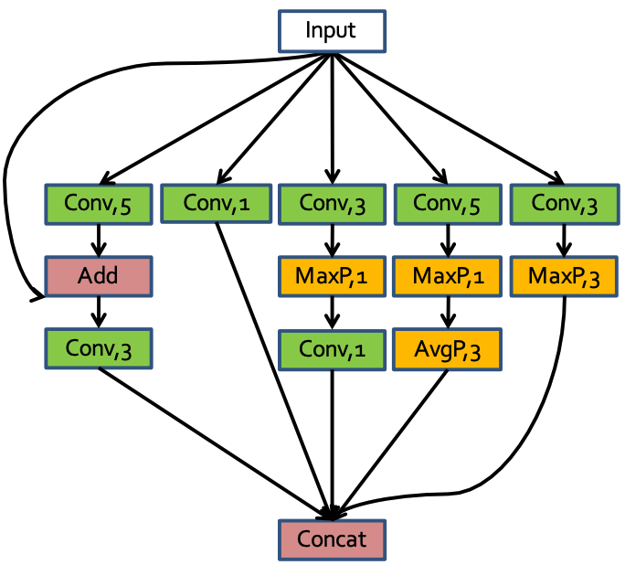
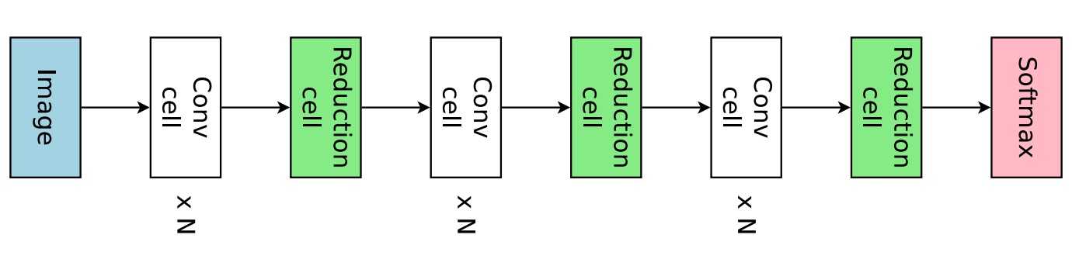
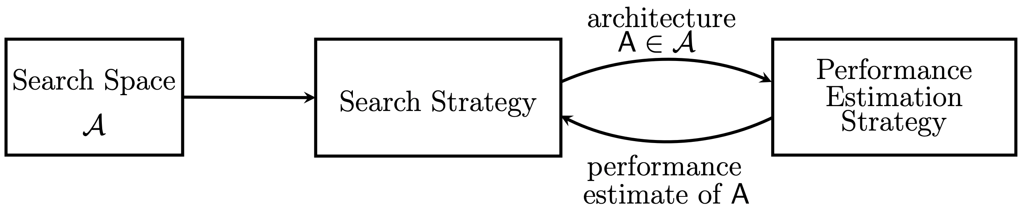
Background: Neural Architecture Search
Automate the process of designing neural network architectures.
Search space: micro and macro.
Zhong et al., 2017
Elsken et al., 2019, arxiv.org/abs/1808.05377
Notes:
Design

Slide 6
Background: Neural Architecture Search
Automate the process of designing neural network architectures.
Search space: micro and macro.
Search Strategy: RL, EA, and Gradient.
Elsken et al., 2019, arxiv.org/abs/1808.05377
Notes:
Design

Slide 7
Background: Neural Architecture Search
Automate the process of designing neural network architectures.
Search space: micro, macro.
Search Strategy: RL, EA, and Gradient.
  Performance Estimation Strategy: Proxy models, and weight sharing.
Elsken et al., 2019, arxiv.org/abs/1808.05377
Notes:
Design

Slide 8
Background: Neural Architecture Search
Venues | Method | S. Space | S. Strategy | P. Estimation | Objectives | Compute Used
ICLR 2017 | NAS | macro | RL | proxy | Accuracy | 22400 GPU-days
CVPR 2017 | GeNet | macro | EA | proxy | Accuracy | 17 GPU-days
ICLR 2018 | Hierarchical | micro | EA | proxy | Accuracy | 300 GPU-days
ICML 2018 | ENAS | both | RL | w.s. | Accuracy | 1 GPU-day
CVPR 2018 | NASNet | micro | RL | proxy | Accuracy | 2000 GPU-days
AAAI 2019 | AmoebaNet | micro | EA | proxy | Accuracy | 3000 GPU-days
ICLR 2019 | DARTS | micro | G | w.s. | Accuracy | 4 GPU -days
CVPR 2019 | MNasNet | - | RL | proxy | Accuracy, Latency | 288 GPU-days
ICLR 2019 | Proxyless | - | RL + G | proxy | Accuracy, Latency | 9 GPU-day
TEVC 2019 | AE-CNN | macro | EA | proxy | Accuracy | 8 GPU-days
Notes:
Design

Slide 9
Motivation and Questions
Real-world deployment of DNN is subject to hardware constraints, e.g. memory, FLOPs, latency, etc.
Through multi-objective optimization:
  Can we design a NAS method to find a portfolio of architectures for different deployment scenarios?
  Will the diversity provided from the additional objective of minimizing network complexity contribute to finding more efficient architectures?
Figure: Overview of the stages of NSGA-Net
Notes:
Design

Slide 10
NSGA-Net: Encoding
Macro search space (binary string):
1 | - | 0 | 1 | - | 1 | 0 | 1 | - | 1
1
2
3
4
Input node
3x3 Conv. + BN + ReLU
Output Node
Notes:
Design

Slide 11
NSGA-Net: Encoding
Macro search space (binary string):
1 | - | 0 | 1 | - | 1 | 0 | 1 | - | 1
1
2
3
4
Input node
3x3 Conv. + BN + ReLU
Output Node
Notes:
Design

Slide 12
NSGA-Net: Encoding
Macro search space (binary string):
1 | - | 0 | 1 | - | 1 | 0 | 1 | - | 1
1
2
3
4
Input node
3x3 Conv. + BN + ReLU
Output Node
Notes:
Design

Slide 13
NSGA-Net: Encoding
Macro search space (binary string):
1 | - | 0 | 1 | - | 1 | 0 | 1 | - | 1
1
2
3
4
Input node
3x3 Conv. + BN + ReLU
Output Node
Notes:
Design

Slide 14
NSGA-Net: Encoding
Macro search space (binary string):
1 | - | 0 | 1 | - | 1 | 0 | 1 | - | 1
1
2
3
4
Input node
3x3 Conv. + BN + ReLU
Output Node
Notes:
Design

Slide 15
NSGA-Net: Encoding
Macro search space (binary string):
1 | - | 0 | 1 | - | 1 | 0 | 1 | - | 1
1
2
3
4
Input node
3x3 Conv. + BN + ReLU
Output Node
Notes:
Design

Slide 16
NSGA-Net: Encoding
Macro search space (binary string):
connect nodes that have output but no input to input node.
1 | - | 0 | 1 | - | 1 | 0 | 1 | - | 1
1
2
3
4
Input node
3x3 Conv. + BN + ReLU
Output Node
Notes:
Design

Slide 17
NSGA-Net: Encoding
Macro search space (binary string):
connect nodes that have output but no input to input node.
connect nodes that have input but no output to output node.
originally proposed by Xie et al. 2017.
we modify by adding an extra bit to indicate bypass connection from input to output node.
1 | - | 0 | 1 | - | 1 | 0 | 1 | - | 1
1
2
3
4
Input node
3x3 Conv. + BN + ReLU
Output Node
Notes:
Design

Slide 18
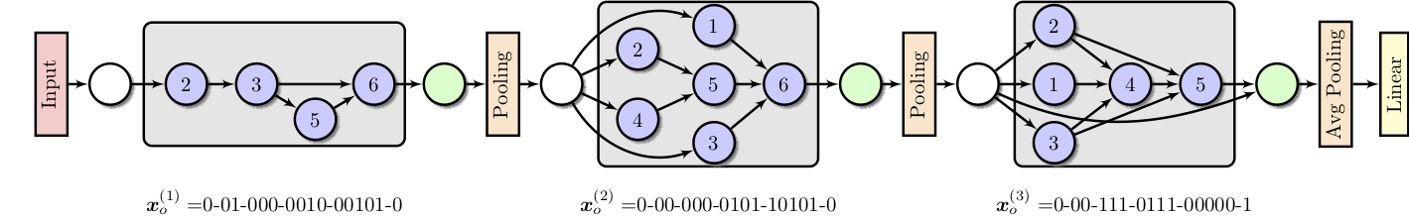
NSGA-Net: Encoding
An example of macro search space encoded architecture:
Notes:
Design

Slide 19
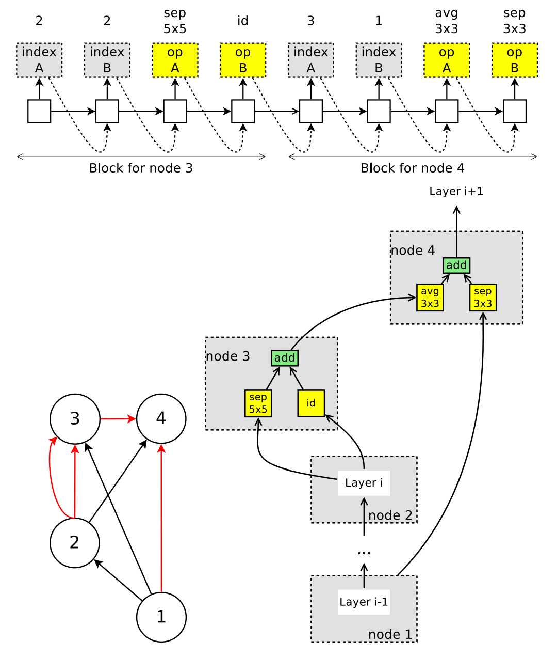
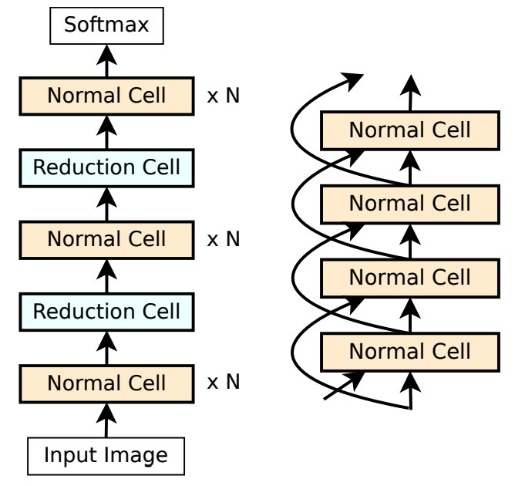
NSGA-Net: Encoding
Micro search space:
  NASNet Search Space proposed by Zoph et al. 2017. arxiv.org/abs/1707.07012
  In additional, we also search the # of filters along with whether or not to apply SE* for each cell.
Notes:
Design

Slide 20
NSGA-Net: Recombination
  Preserve the common sub-structure shared between parents by inheriting common bits.
P1 |  | 1 | 0 | 1 | 0 | 0 | 1 | 0
P2 |  | 1 | 1 | 1 | 1 | 1 | 1 | 0
Notes:
Design

Slide 21
NSGA-Net: Recombination
  Preserve the common sub-structure shared between parents by inheriting common bits.
P1 |  | 1 | 0 | 1 | 0 | 0 | 1 | 0
P2 |  | 1 | 1 | 1 | 1 | 1 | 1 | 0
C |  | 1 | ? | 1 | ? | ? | 1 | 0
Notes:
Design

Slide 22
NSGA-Net: Recombination
  Preserve the common sub-structure shared between parents by inheriting common bits.
  Maintain the same complexity between parents and offspring.
P1 |  | 1 | 0 | 1 | 0 | 0 | 1 | 0
P2 |  | 1 | 1 | 1 | 1 | 1 | 1 | 0
C |  | 1 | ? | 1 | ? | ? | 1 | 0
Notes:
Design

Slide 23
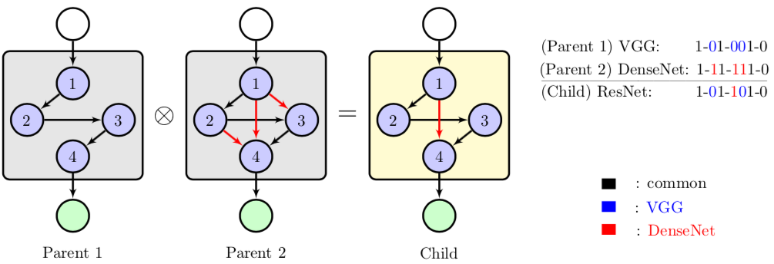
NSGA-Net: Recombination
  Preserve the common sub-structure shared between parents by inheriting common bits.
  Maintain the same complexity between parents and offspring.
P1 |  | 1 | 0 | 1 | 0 | 0 | 1 | 0
P2 |  | 1 | 1 | 1 | 1 | 1 | 1 | 0
C |  | 1 | 0 | 1 | 1 | 0 | 1 | 0
Figure: Recombination of Network Architectures
Notes:
Design

Slide 24
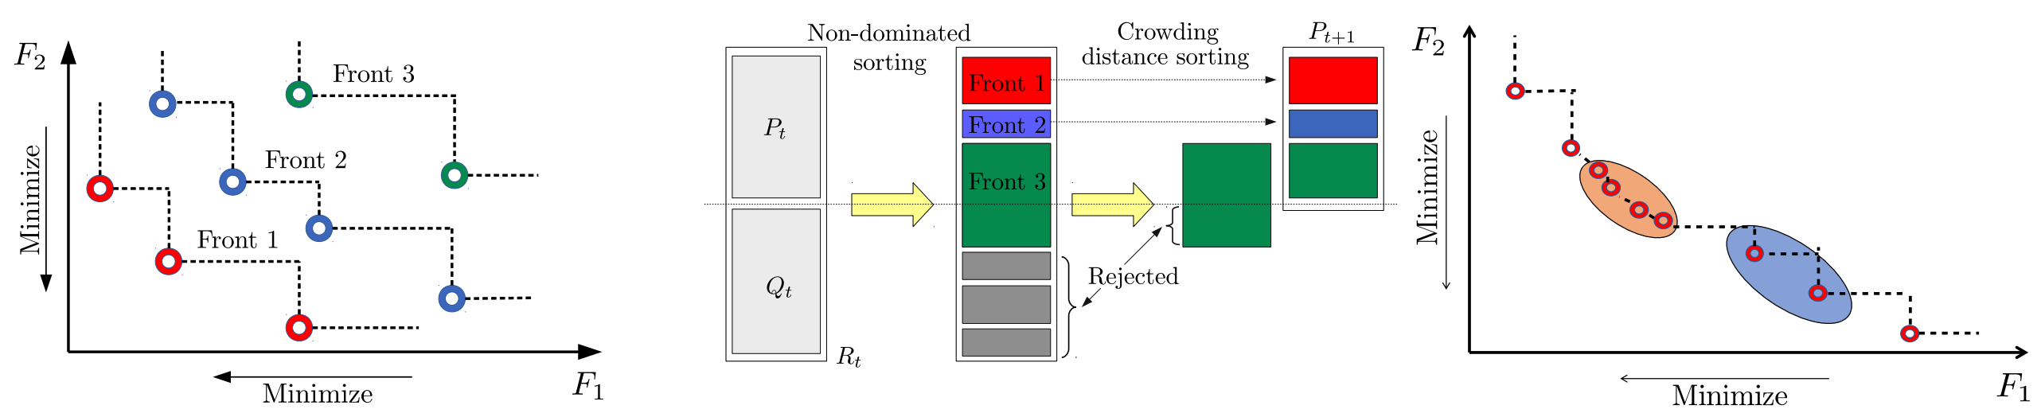
NSGA-Net: Selection Process
Two objectives considered:
  Maximize architecture performance (measured by validation accuracy).
  Minimize architecture complexity (measured by FLOPs).
NSGA-Net’s principles of selecting neural network architectures:
  Prefers architectures that are better in all objectives (ND-sorting).
  Prefers architectures that preserve different trade-off information (crowding-distance).
Figure: Non-domination and crowdedness based selection process

Slide 25
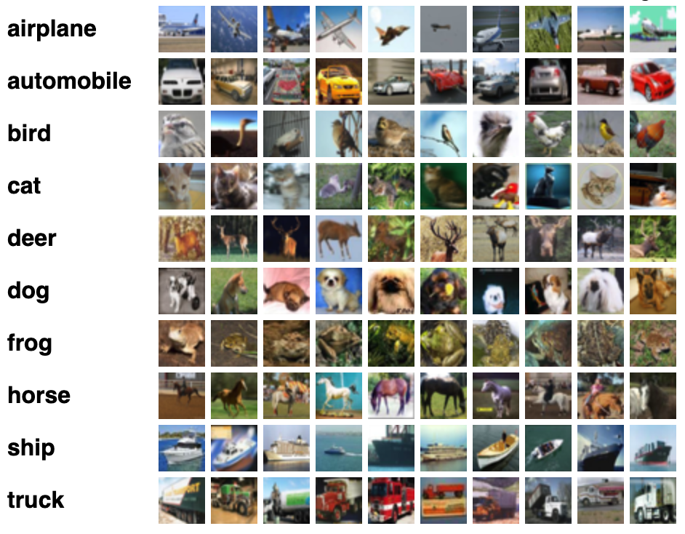
Experiments and Results
Dataset: CIFAR-10
10 classes, 32 x 32 color images, 50,000 training, 10,000 testing.
Never used during search.

Slide 26
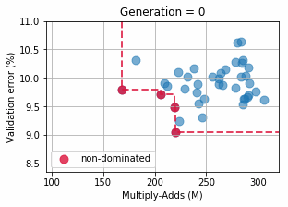
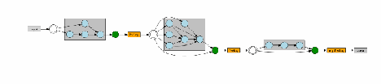
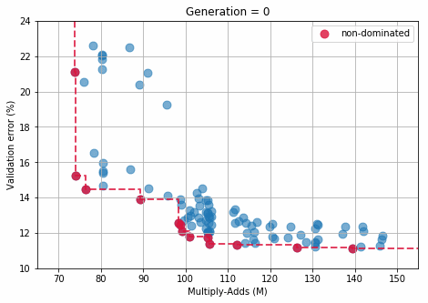
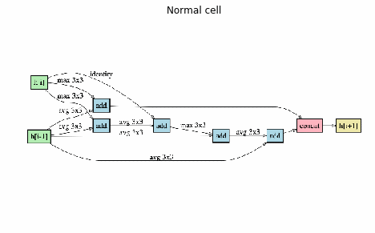
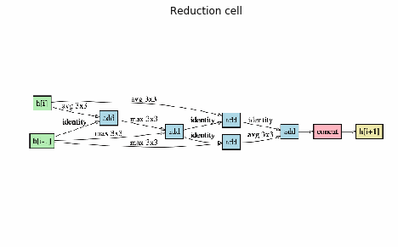
Search in Process
Macro search space (non-repeating structure)
Micro search space (repeating structure)

Slide 27
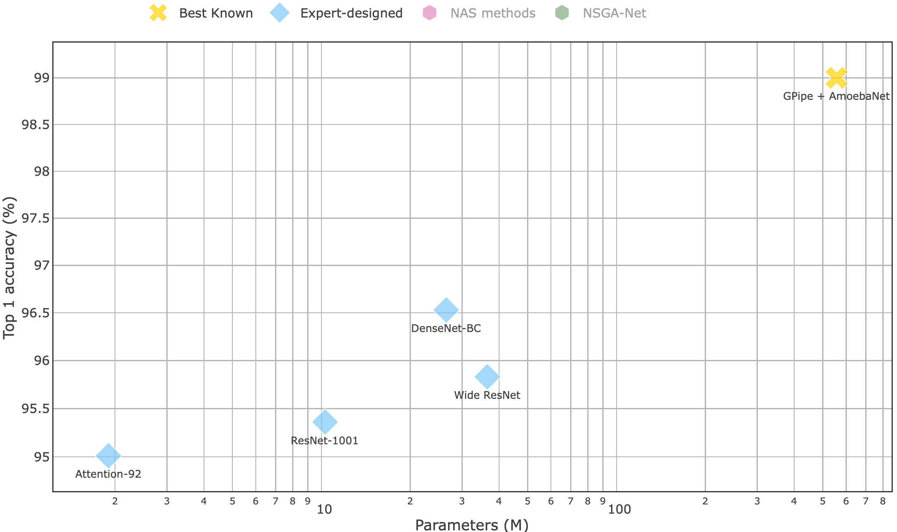
Results on CIFAR-10

Slide 28
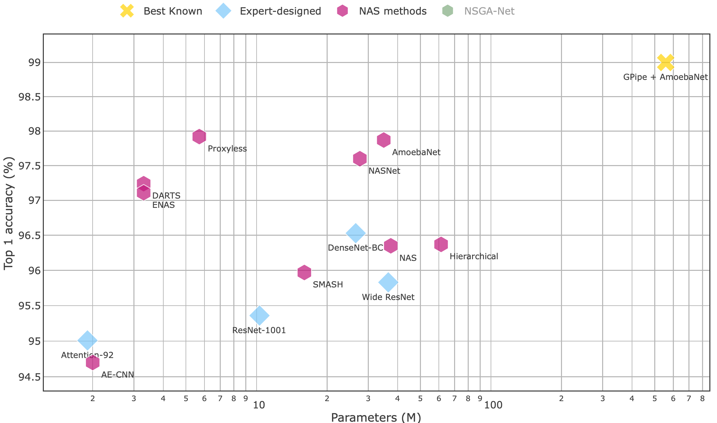
Results on CIFAR-10
NAS: ICLR 2017
NasNet: CVPR 2018
ENAS: ICML 2018
Hierarchical: ICLR 2018
AmoebaNet: AAAI 2019
DARTS: ICLR 2019
Proxyless: ICLR 2019
AE-CNN: TEVC 2019

Slide 29
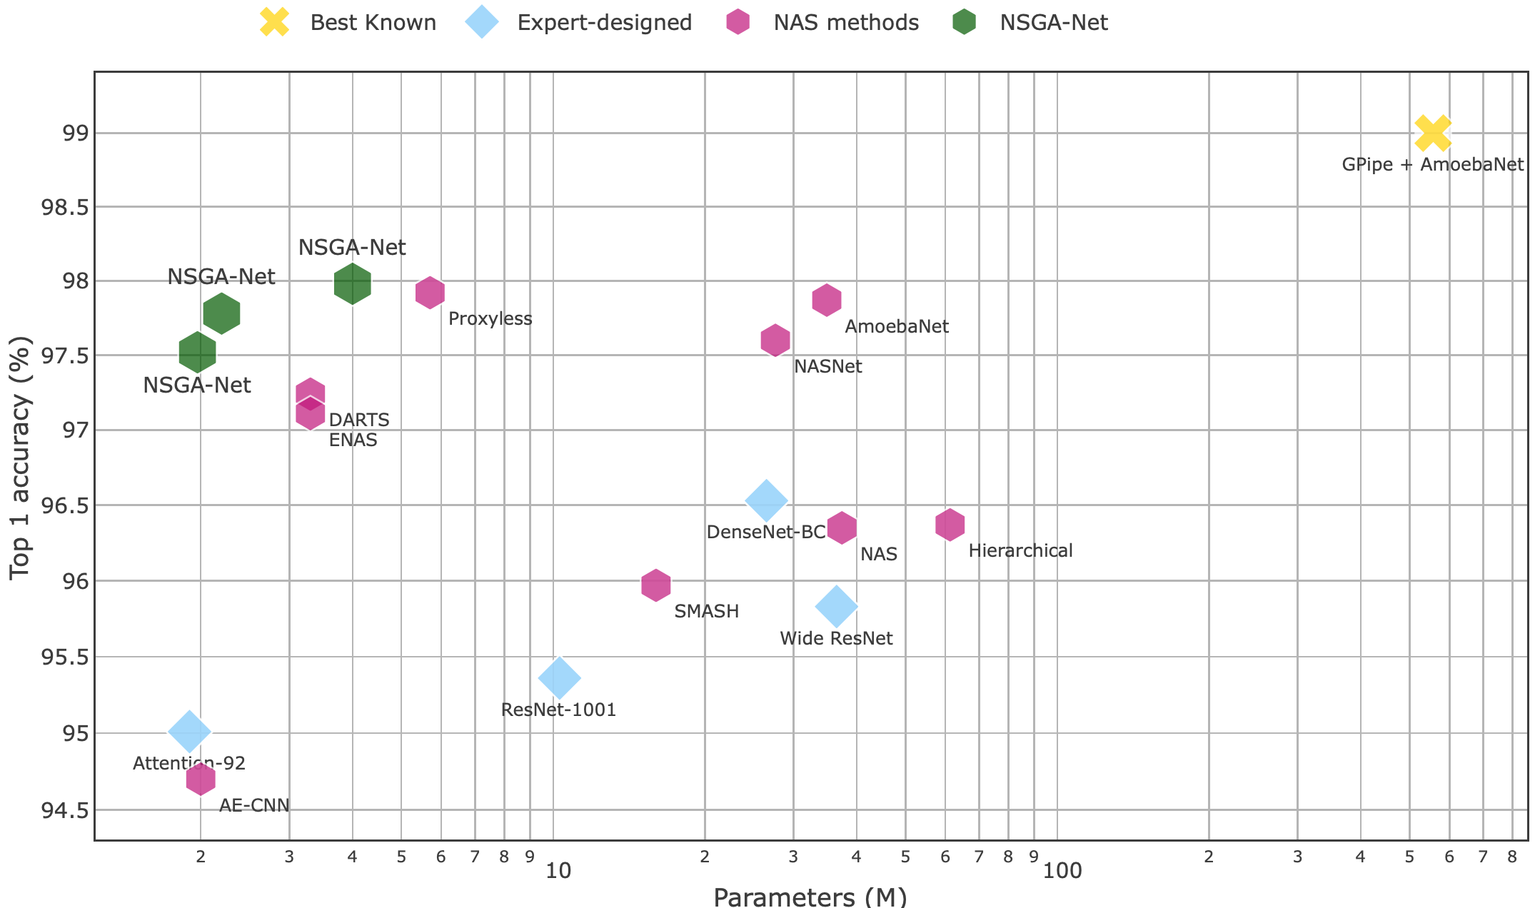
Results on CIFAR-10

Slide 30
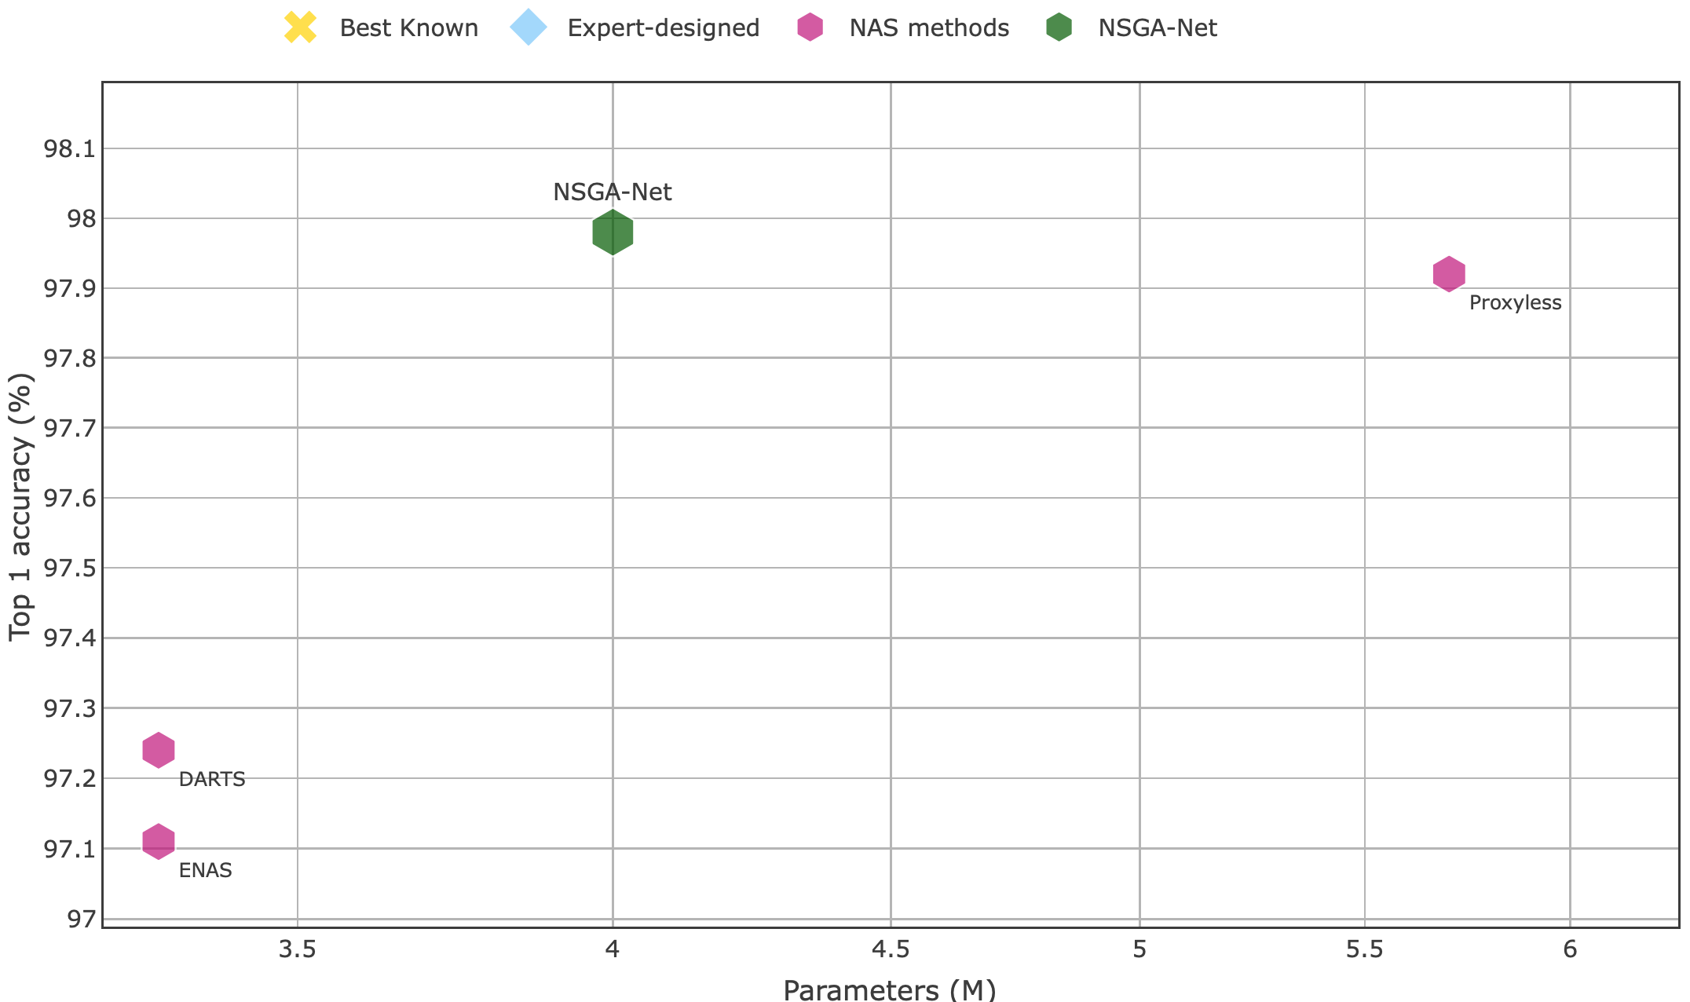
Results on CIFAR-10
  ~1.7M less

Slide 31
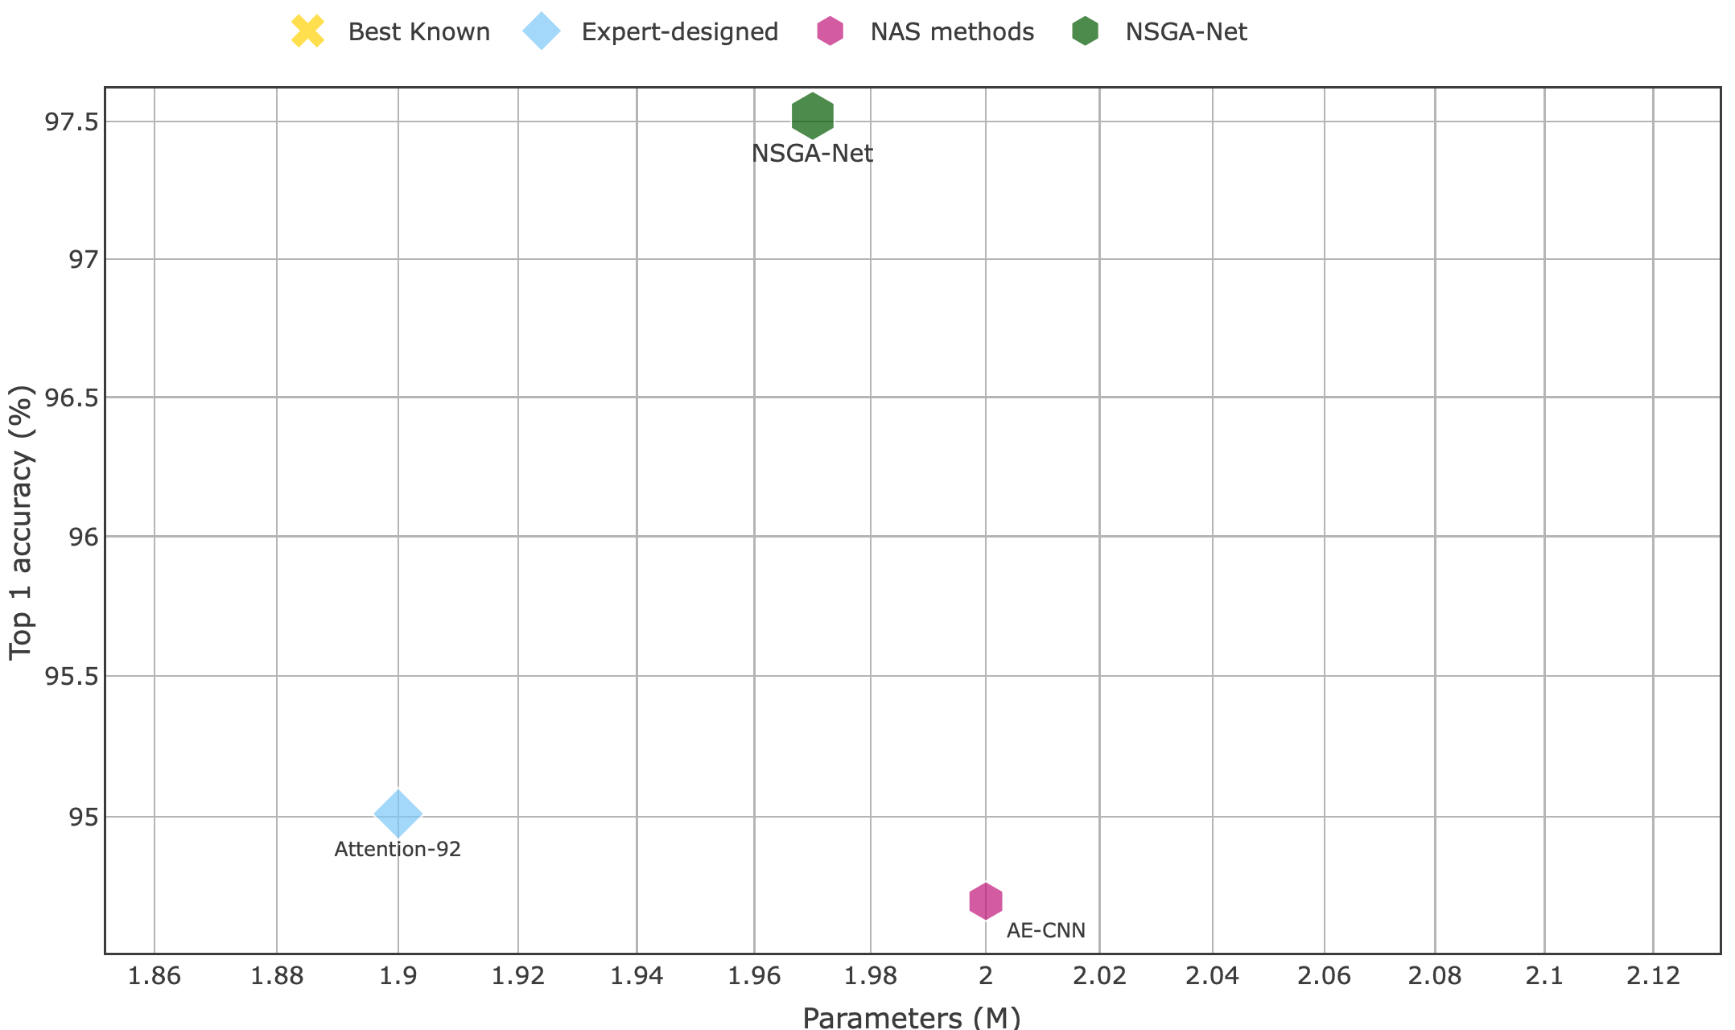
Results on CIFAR-10
  ~3% more

Slide 32
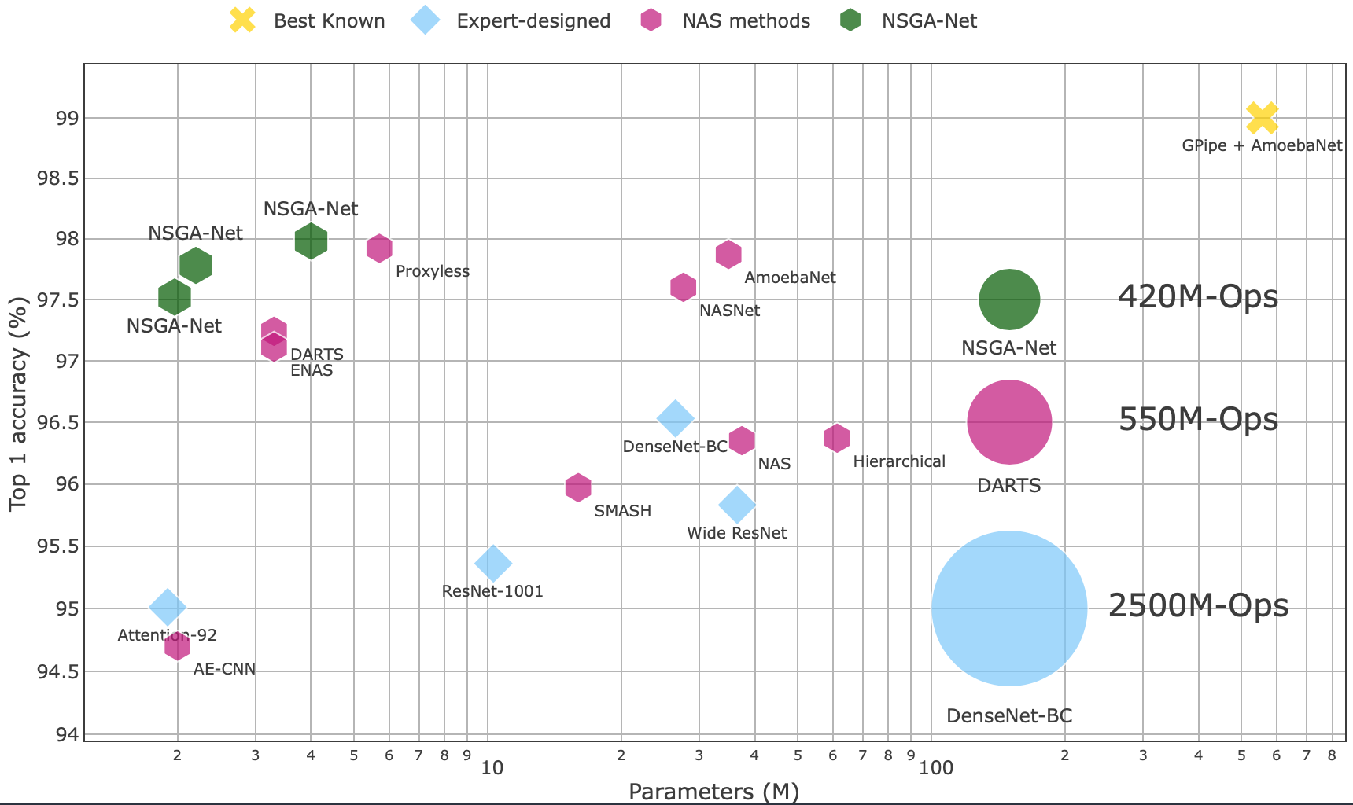
Results on CIFAR-10

Slide 33
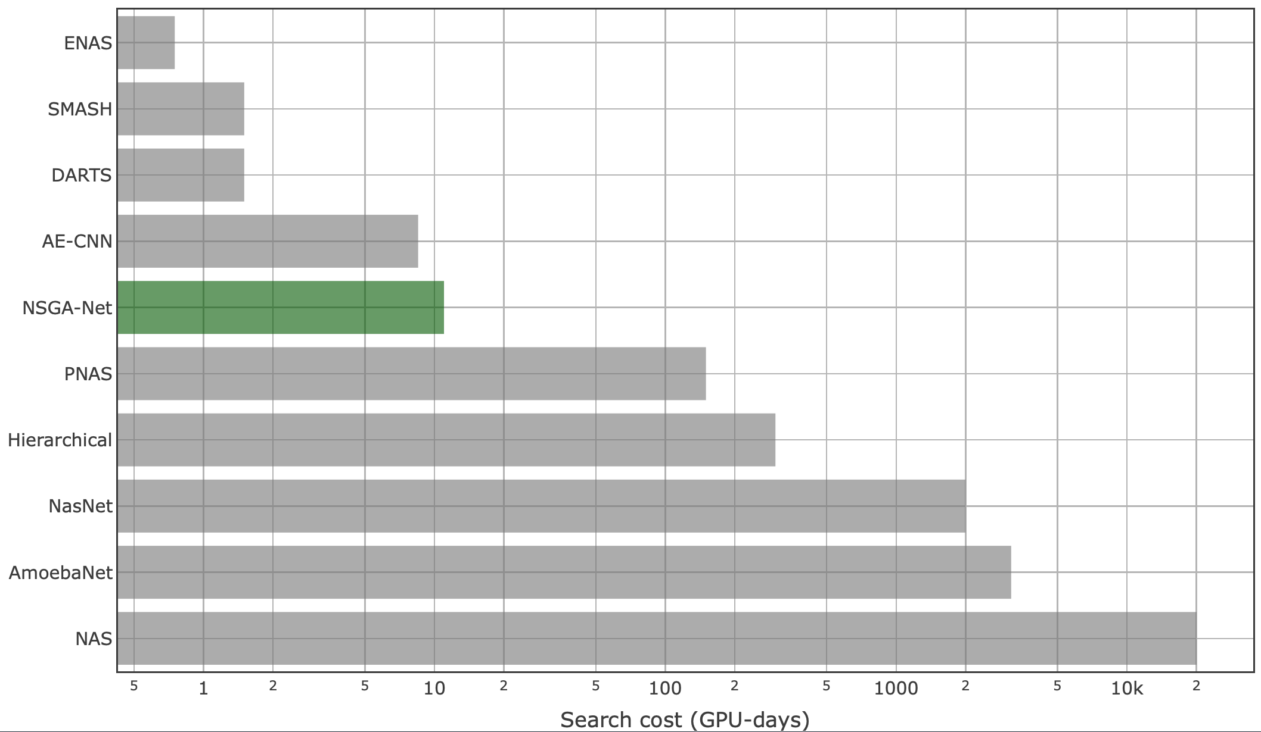
Results on CIFAR-10
  < 1 week w/ 2 GPUs
  < 2 days w/ 8 GPUs

Slide 34
Results on CIFAR-10

Slide 35
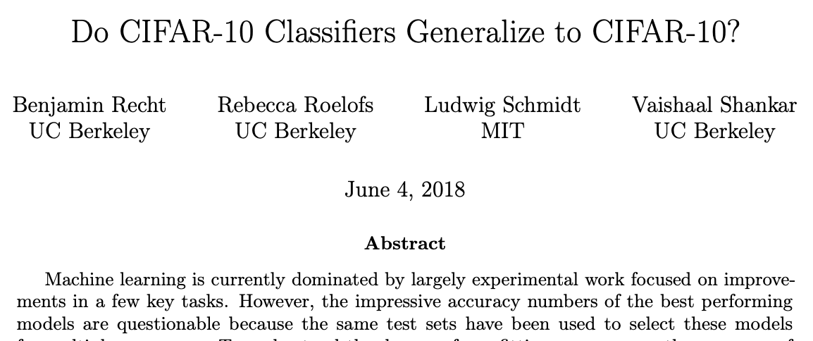
CIFAR-10 Results Validation
How reliable are the current measures of progress?
Recht et al., 2018, arxiv.org/abs/1806.00451

Slide 36
CIFAR-10 Results Validation
How reliable are the current measures of progress?
CIFAR-10.1 (Recht et al., 2018, arxiv.org/abs/1806.00451)
  A new truly unseen CIFAR-10 testing set.
  10,000 images collected following the same procedure.

Slide 37
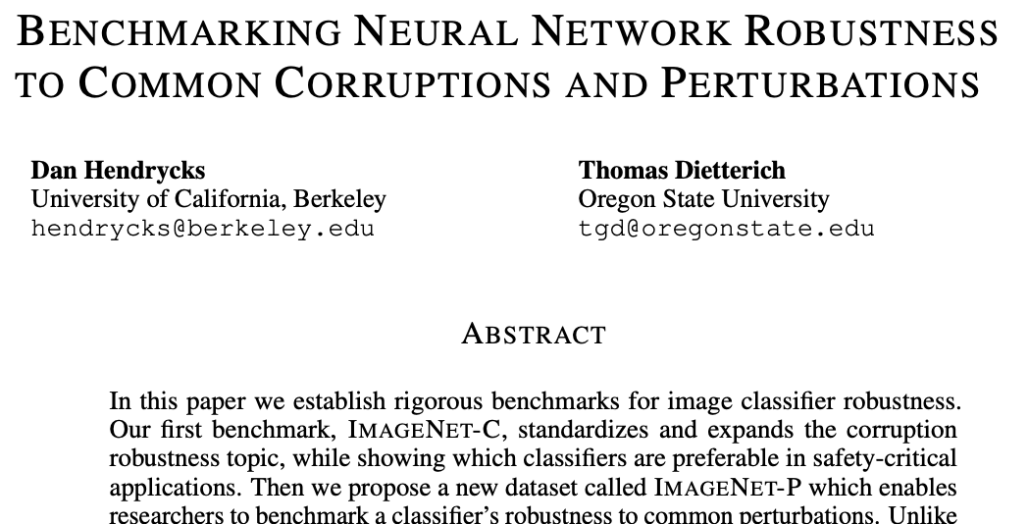
CIFAR-10 Results Validation
How reliable are the current measures of progress?
Hendrycks et al., ICLR 2019

Slide 38
CIFAR-10 Results Validation
How reliable are the current measures of progress?
CIFAR-10.1 (Recht et al., 2018, arxiv.org/abs/1806.00451)
  A new truly unseen CIFAR-10 test set.
  10,000 images collected following the procedure.
CIFAR-10-C (Hendrycks et al., ICLR 2019)
  ~ 1 M. new images created from original CIFAR-10 test set.
  19 different corruption types, in 5 different severity for each type.

Slide 39
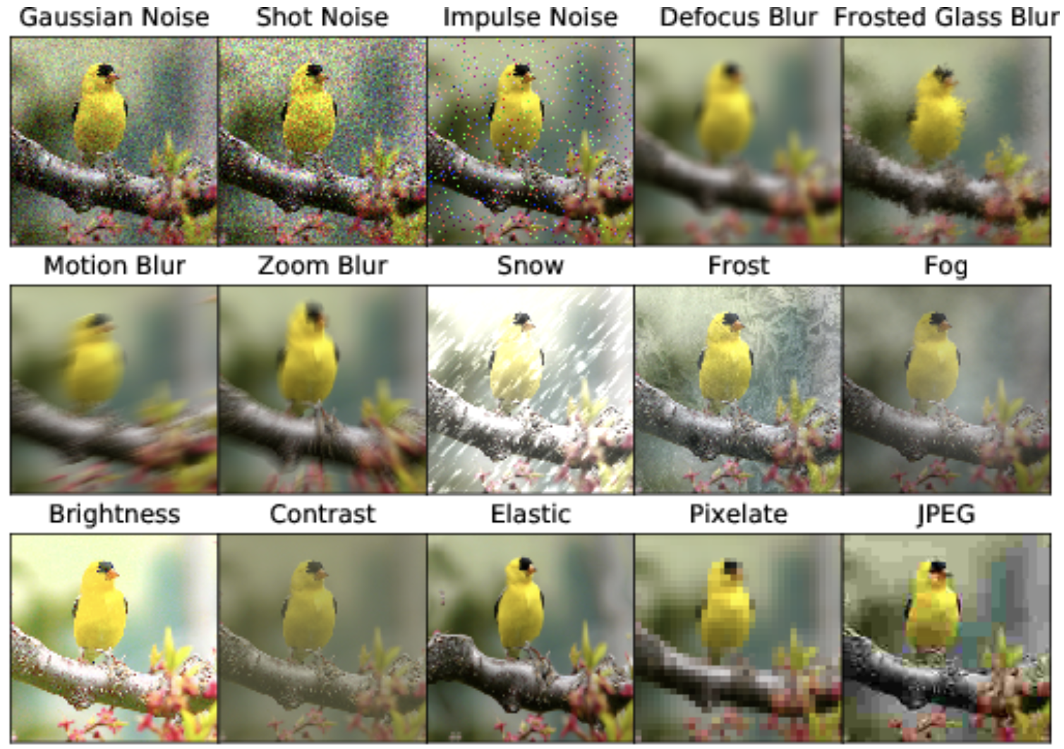
CIFAR-10 Results Validation
Corruption examples
Hendrycks et al., https://github.com/hendrycks/robustness

Slide 40
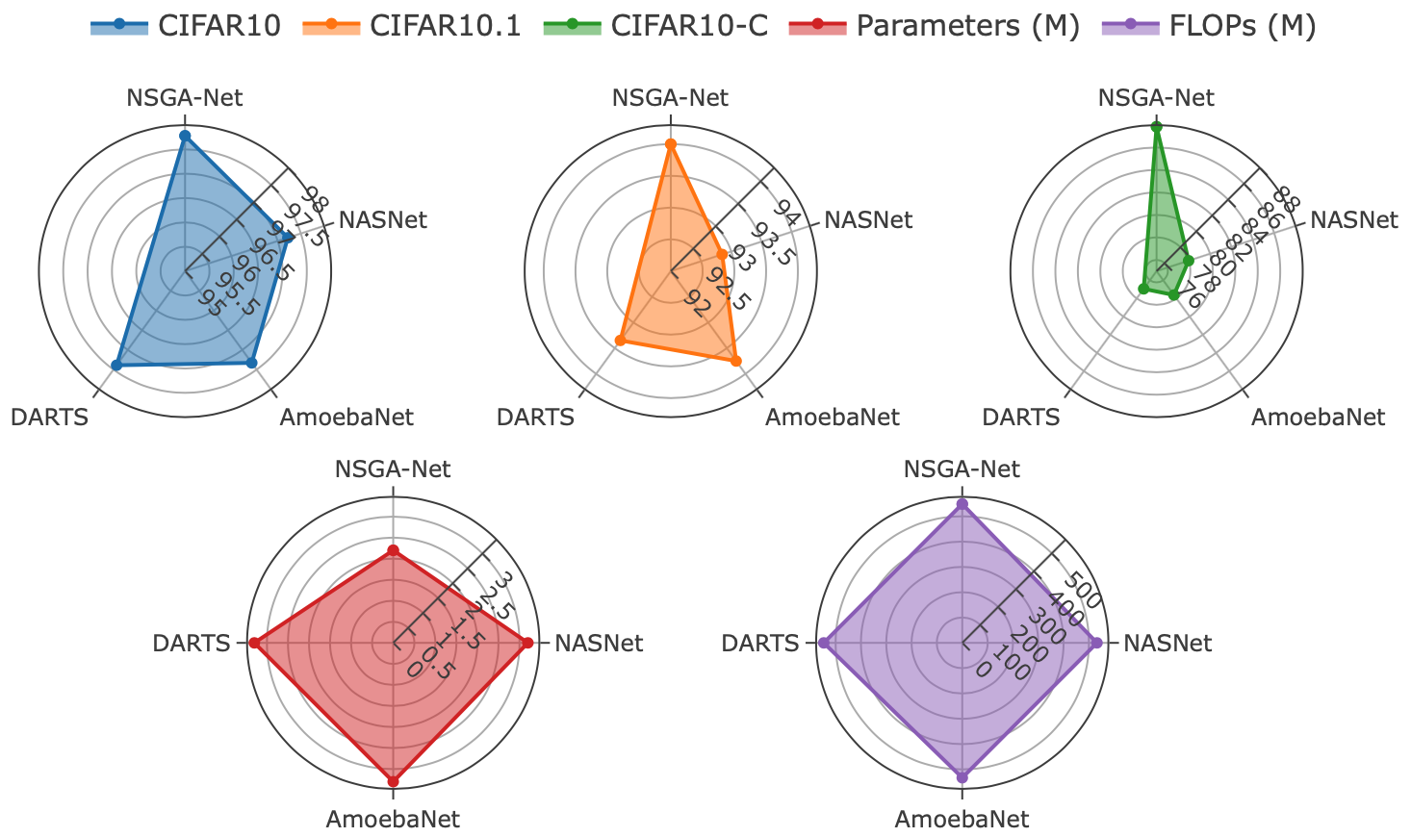
CIFAR-10 Results Validation
NasNet: RL
AmoebaNet: EA
DARTS: Gradient

Slide 41
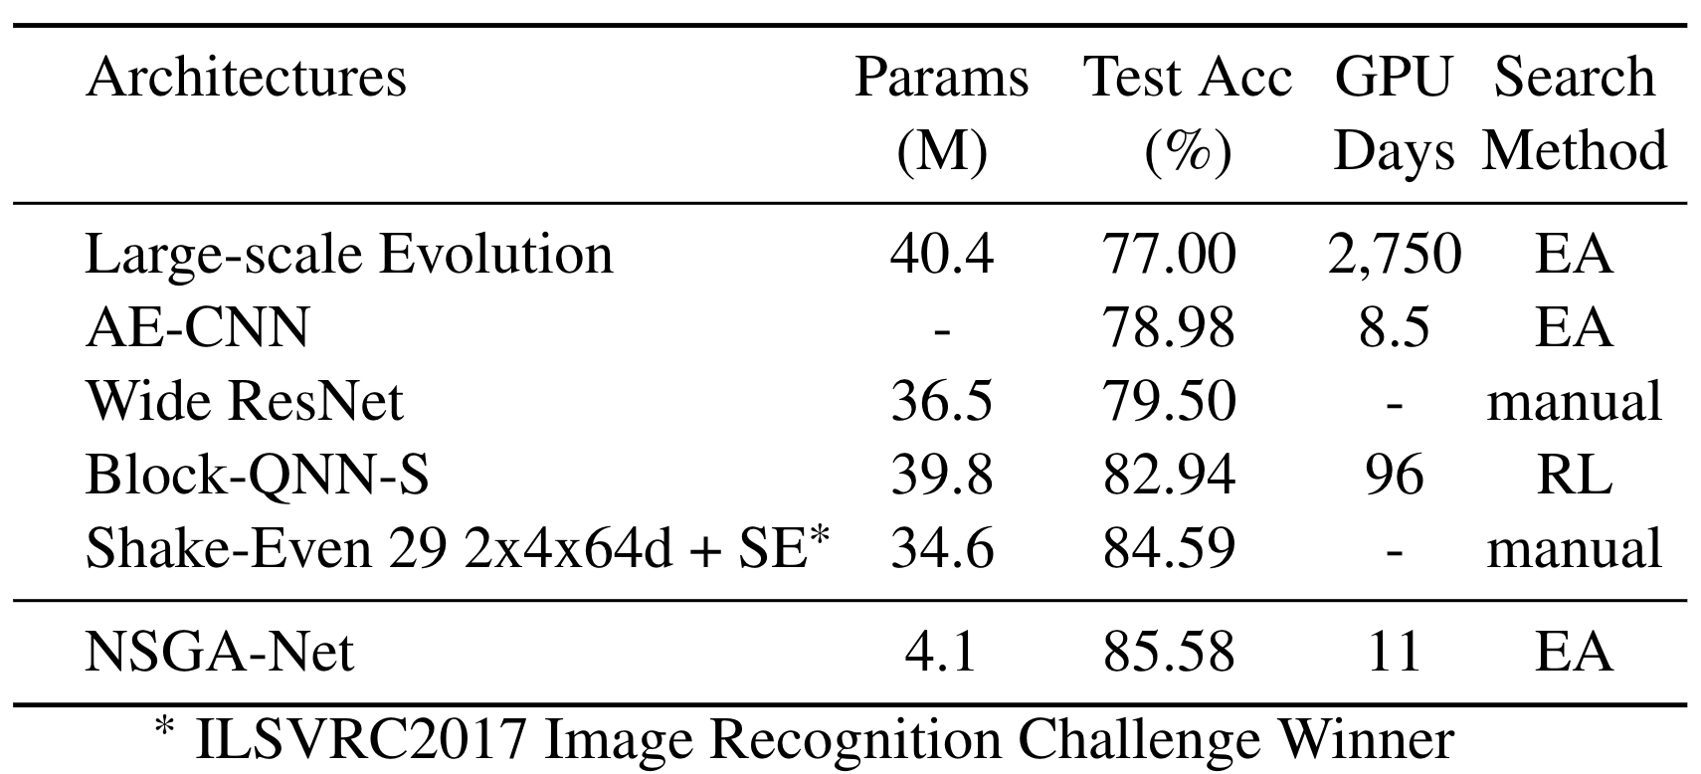
Additional Results
Transferability to CIFAR-100

Slide 42
Conclusions
NSGA-Net achieves a portfolio of architectures offering efficient trade-offs between complexity and performance on CIFAR-10 dataset.
Experiments on additional test data, data under common corruptions and more challenged dataset further validate the architecture progress made by NSGA-Net.
Implications: (1) EA offers a viable alternative to traditional ML techniques; (2) The scope of multi-objective in ML.
Caveats: search space is heavily prior-knowledge biased.

Slide 43
Code and Model Release
We have released NSGA-Net models trained on various datasets.
  https://github.com/ianwhale/nsga-net
Thank You !

